Slide 2
ET4730 Computer Graphics

Slide 3

OpenGL SL
Lecturer: Nguyen Dinh Van, PhD.

Slide 4
Content
OpenGL Shader Language - GLSL
OpenGL Math - GLM
Practice

Slide 5
1. OpenGL Shader Language
GLSL Syntax
Shader
Interfaces

Slide 6
GLSL Syntax
Data types: scalar, vector, matrix, structure, array, …
Scalar:
float; double; bool; int; uint
Vectors:
vec{2,3,4} : a vector of 2, 3, 4 floats
dvec{2,3,4} : a vector of 2, 3, 4 double
bvec{2,3,4} : a vector of 2, 3, 4 bool
ivec{2,3,4} : a vector of 2, 3, 4 integer
uvec{2,3,4} : a vector of 2, 3, 4 unsigned integer
Example: vec2 vector2Dvariable;
Accessing element in vector: x, y, z, w components

Slide 7
GLSL Syntax
Matrix:
Square matrices: matn mat{2,3,4}, dmat{2,3,4}
Non-square: matnxm (ex: mat4x3: 4 cols, 3 rows)
dmat (double precision) only available from GL 4.0
Accessing element in matrix in array style
mat3x4 matrix; // non-square matrix 4x3
matrix[2][0]; // first entry of the third columns
mat3 theMatrix; // square matrix 3x3
theMatrix[1][2]; // equivalence to theMatrix[1].z

Slide 8
GLSL Syntax
Structure:
Similar syntax as C
struct dirlight {
vec3 direction;
vec3 color;
};

Slide 9
GLSL Syntax
Array:
Similar syntax as C
Must have pre-defined number of elements
Example:
float arrayFloat[12];
arrayFloat.length() // returns 12

Slide 10
Statement
Same syntax as C
If else, for, while, do while, etc.
Function:
The main function: void main(){/* … */}
Custom function defined similar to C style
Can be overloaded
Can use recursion

Slide 11
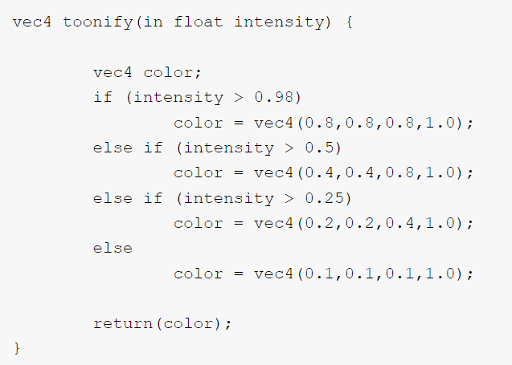
Statement
Example for a function:

Slide 12
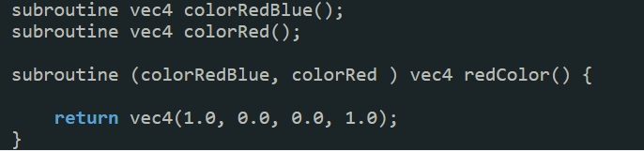
Subrountine
A mechanism for Shader programs to be configurable without the need of re-compiling
Example

Slide 13
Shader
OpenGL allows creating variables which are unrelated to vertices
Can be used to apply effect (lighting, color, …) to shape
There are two categories of variables in GLSL:
Uniform
A constant for all vertices in an OpenGL draw call.
Global variable whose values do not change for every vertex in an OpenGL draw call
Attribute
Specific for vertices (location, texture, ..)
To be introduced later

Slide 14
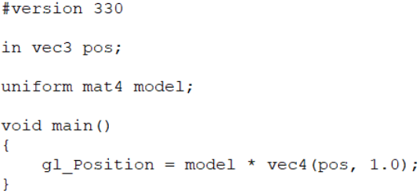
Shader
Uniform variable:
A global variable like in C style
Accessible with a unique name
Add uniform before data type (mat4, vec3, etc.)
Example:

Slide 15
Shader
Uniform variable:
A uniform variable has a fixed location ID
Can find the variable ID with variable name:
Assign value to the variable using syntax:
int location = glGetUniformLocation(shaderID, "uniformVarName");
glUniform1f(location, 3.5f);

Slide 16
Shader
Uniform variable:
Syntax for common type:
STT | Tên | Mô tả
1 | glUniform1f | Một giá trị float
2 | glUniform1i | Một giá trị integer
3 | glUniform4f | Vector4 của các giá trị float
4 | glUniform4fv | Vector4 của các giá trị float, sử dụng con trỏ
5 | glUniformMatrix4f | Matrix4 của các giá trị float
6 | glUniformMatrix4fv | Matrix4 của các giá trị float, sử dụng con trỏ

Slide 17
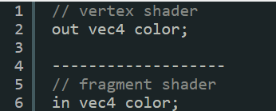
Interfaces
Allow communication between shaders
Vertex shader can communicate with fragment shader
Output of a shader will be copied to be input of a shader in later stage in rendering pipeline
Name-based matching
One mechanism to match output of a shader to input of the next one.
Simple to use but might create confusion

Slide 18
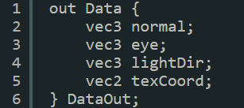
Interfaces
Block based matching
A block can be defined as follow:
Output
Block name
Block element
Block instance

Slide 19
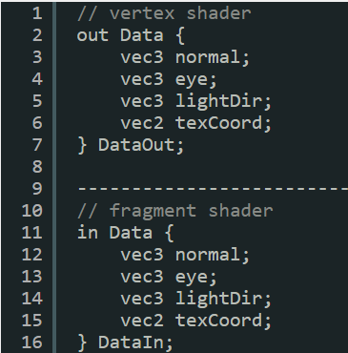
Interfaces
Access block element inside a shader function
Using block instance
Send block to next stage:
Name-based matching for Block name
Example: block name data is matched from output of vertex shader to input of fragment shader
Block of the same name must have the same elements

Slide 20
2. OpenGL Math Library
GLM
Transformation

Slide 21
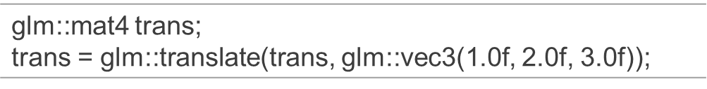
GLM
A math library for OpenGL
Facilitate matrix calculation (transformation such as: translation, rotation, etc.)
Use namespace glm
Easy to use:
glm::mat4 trans: create an identity matrix 4x4
glm::translate(trans, offsetVector): create a 4x4 matrix for translation given displacement in offsetVector
Note: glm uses matrix 4x4

Slide 22
GLM
Download GLM:
https://glm.g-truc.net/0.9.9/
Configure with visual studio:
Only header file needed
Project Properties > C/C++ > General > Additional Include Directories
Add libs/glm

Slide 23
Transformation
Step to translate a triangle:
Declare a uniform 4x4 matrix variable named “model” in shader
Find a remember the model location ID when compile the shader
Create a translation matrix using glm in the main program.
Bind the model with the translation matrix

Slide 24
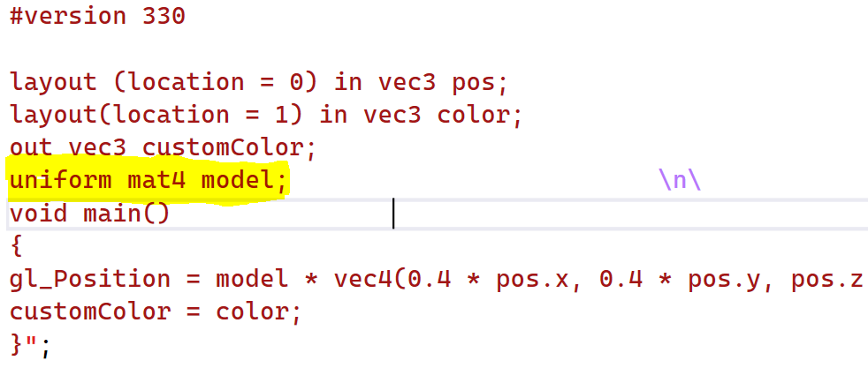
Transformation
Step 1: create uniform model mat4 in shader

Slide 25
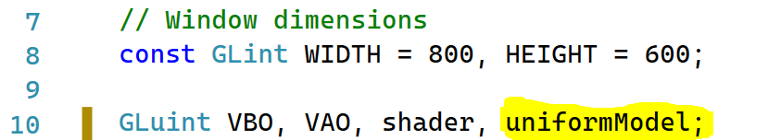
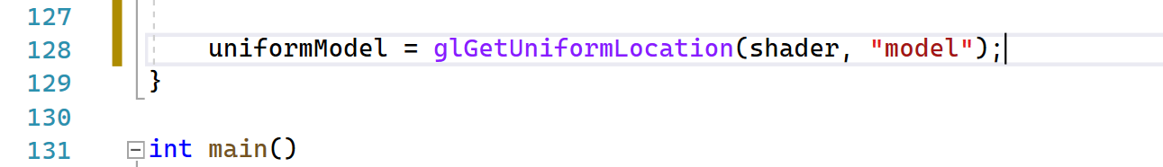
Transformation
Step 2: Find and remember location of model
In CompileShaders()

Slide 26
Transformation
Step 3: Create translation matrix using glm
Create an identity matrix 4x4
Use translate function from glm to create a translation matrix with offset is a 3d vector
In this case, the offset is (0.5f, 0.5f, 0.0f)

Slide 27
Transformation
Step 4: Bind the translation matrix to the uniform model
glUniformMatrix4fv(): for matrix4x4 with pointer
Reference: here
void glUniformMatrix4fv( | GLint location,
 | GLsizei count,
 | GLboolean transpose,
 | const GLfloat *value);

Slide 28
3. Practice

Slide 29
Practice
Try to scale, rotate a triangle
Apply multiple transformations on a triangle

Slide 30
THANK YOU !

